Slide 1
Project Report
Title: RISC-V pipelined Data path.
PAGES:
Page 1
Page 2 – 3
Page 3 – 4
Page 5
Page 6
Page 7
Page 8
Page 9
Page 10
Page 11-17
Page 17-24
Page 25
:
:
:
:
:
:
:
:
:
:
:
:
Objective, Problem statement.
Motivation for pipelining.(Why pipelining)
Challenges for pipelining.
Pictorial view of pipelined data path.
Features of the data path. Role of instruction cache and program counter.
Role of decoder unit, register file.
Role Immediate generator, Data cache, 64-bit ALU.
Control Signals
Forwarding Unit
Verilog code of data path and test bench.
Observation of timing diagram and working of data path. Timing reports
Power consumption and further extensions possible and contribution.

Slide 2
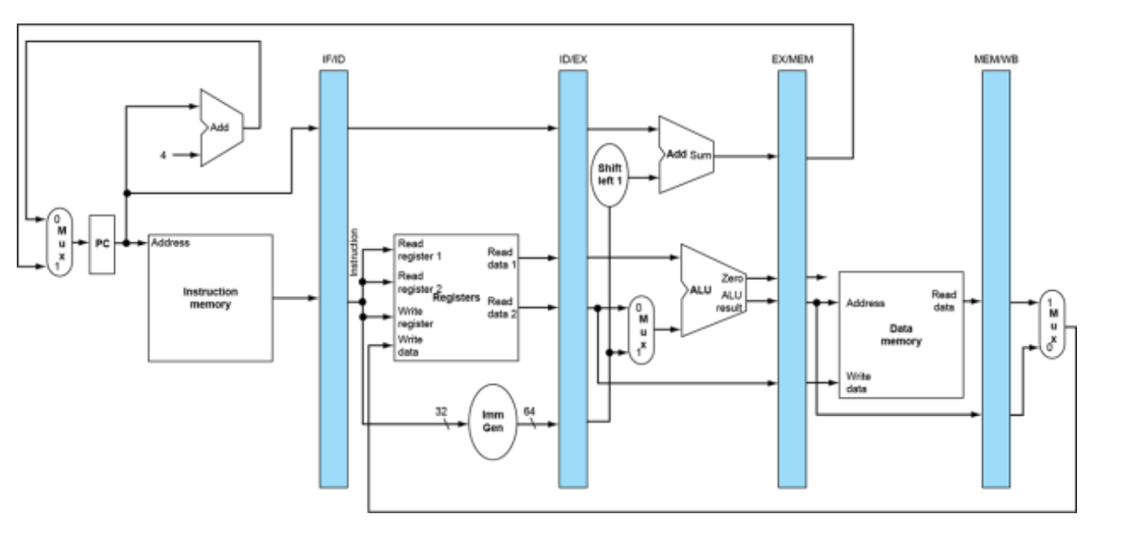
Page: 1
TEAM:
Team Number: 9
Name : Chekkala Sandeep Reddy (Team lead)
Roll Number : 112101011
Name: Sunapral Swarnalatha Bai
Roll Number: 112101003
Name: Supraja
Roll Number: 112101049
Laboratory : 7
Course: CS2160 Computer Organisation Laboratory (Jan-May 2023)
Designing Pipelined RISC-V Data path.
Objective:
The objective of this LAB is to design a 4 stage RISC-V pipelined data path.
Problem Statement:
In this lab, you are required to add instruction cache (I-Cache) and data cache (D-Cache) in your existing RISC-V data-path RTL. Both I-Cache and D-Cache should be able to store a minimum of 8 32-bit data. The final data-path should be similar to reference design shown below:
RISC-V 5 stage pipeline.
You can store value 45 and -20 in the D-Cache initially,

Slide 3

Page: 3
Challenges in pipelining:
Speed up issues when unbalanced.
If the time taken by all stages is same (that is balanced) then we can say that ${\left(tⅈmⅇ\right)}_{pipelined}=\frac{{\left(tⅈmⅇ\right)}_{non−pipelined}}{Number of stages}$
But in general the stages are not balanced, so we do not get the ideal speed up as written in the above formulae. The throughput will be less than expected. But the throughput of pipelined datapath will be far better than non-pipelined datapath.
Eg: if the time needed for ID stage is less than EX stage, when these both stages are executing in the same clock cycle, ID stage should wait for getting next computation until the EX stage gets completed.
Figure : ID , WB stages take less time(register operations) than other stages:
}
IF
ID
EX
MEM
WB
IF
ID
}
EX
MEM
WB

Slide 4
Page: 4
2) Hazards
Structural Hazards
Conflict for use of resource, IF and MEM stage requires memory or cache element but if there is only one cache then a requirement of bubble is happening, so this can be avoided by giving two different caches Instruction-cache and Data-cache.
Data Hazards
An instruction depends on completion of previous instruction, this type of issue is known as Data dependencies.
Eg:
1) I1: addi x9, x10, 2
I2: addi x11, x9, x4
I2 depeneds on I1 because this is Write after read dependency
In the above case, WB is done in the first half of cycle and then ID.
Not all data dependencies can be avoided by forwarding, if the instruction is ld instruction and next instruction is reading the register then there is a need of one bubble even when there is forwarding.
Control Hazards.
When a instruction is branch instruction the next instruction depends on the result of branch instruction. So there are many methods for overcoming this some of them are 1) Computing branch at the ID stage (this needs one bubble) 2) branch predictors ( dynamic and static branch predictors). Handling control hazards is out of the scope of this project.
Figure : Bubbles needed (no forwarding) due to data dependency:
IF
ID
EX
MEM
WB
addi x9, x10, 2
add x11, x9, x4
IF
ID
EX
MEM
WB
Figure : Forwarding (aka bypassing) the above data dependency:
IF
ID
EX
MEM
WB
addi x9, x10, 2
IF
ID
EX
MEM
WB
add x11, x9, x4

Slide 5
Goal:
Page: 6
Use hardware lying as much as possible.(running instructions in parallel though there is no actual parallel hardware)
Minimize the number of stalls
Thereby increasing the performance.
Retaining the simplicity of the hardware.
Features of this data path:
Our main motive of this project is to come close as much as possible to the actual RISC-V pipelined data path. The following features are included in this data path:
Pipelined data path: which allows multiple subtasks to be carried out simultaneously using independent resources.
Important components of Data path:
20 32-bit instruction cache. (can be increased based on requirements)
Program Counter.
Instruction decoder. (R-type, I-type, S-type)
32 64-bit register file.
Immediate Generator.
64-bit ALU(addition, subtraction, multiplication)
20 64-bit Data cache. (can be increase based on requirements)
Pipeline registers(IF/ID, ID/EX, EX/MEM, MEM/WB)
Control Unit. (Generate control signals)
Forwarding unit.
Description of Approach:
Instruction cache stores instructions, when instruction is fetched from it using program counter.
Program counter is used for iterating through the instruction cache. Assuming the cache is byte addressable it is incremented by 4 to do to the next instruction and it is given PC + 2 X imm when there are branch instructions.
Ins-cache
32-bit instruction
Program Counter
64
32
IF/ID register
32
PC_source
1
mux
PC
64 bit Program Counter
Branch address (PC + 2 X imm)
64
IF/ID register
PC + 4
0
New PC value

Slide 6
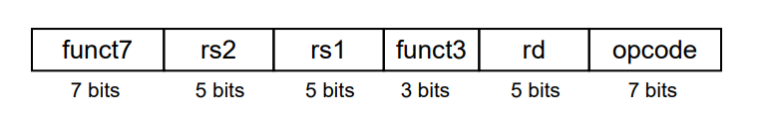
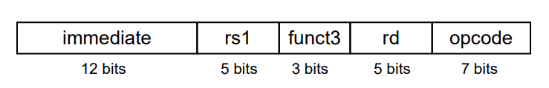
Role of decoder unit and register file in data path:
In this project the decoder unit decodes I, R, S type instructions of RISC-V. The register file has 32 64-bit registers where register read and register write gets executed.
Page: 7
funct7
rs2
rs1
funct3
rd
opcode
I-format:
Immediate
rs1
funct3
rd
opcode
S-format:
32-bit RISC-V instruction
Imm[11:5]
rs2
rs1
funct3
Imm[4:0]
opcode
32

Slide 7
Page: 8
Reg-write
Instruction
Decoder unit
rs1
64
Read_data 1
IF/ID register
32
rs2
64bit Register file
64
Read_data 2
When register write signal is on the data will be written in the corresponding register.
rd
Write_data
ID/EX registers
5
rs1
5
rs2
Immediate(12 bits)
5
Rd(5bits)
Role of Data cache:
The data cache is used to store data values. The access time to access data from data cache is way more than access time to access data from register file. When data read signal is on data is read from data cache, whenever data write signal is on data is written in the data cache.

Slide 8
Control Unit and Control Signals:
Page: 9
S.No | Signals | Role
1) | Register write | If register write signal is 1 the data will be written in the register file. Otherwise data is not written in the register file.
2) | Mem_to_register | If mem_to_register signal is 1 the data read from the data cache (ld) will be write data value for register file. Otherwise alu_result will be the write data value for register file.
3) | Mem_read | If mem_read signal is 1, data value is read from the data cache using the address otherwise the data is not read from the data cache.
4) | Mem_write | If mem_write signal is 1, data value is written in the data cache else the data is not written in the data cache.
5) | PC_source | PC_source will be 1 when the instruction is branch instruction to select PC + 2 X imm Otherwise PC + 4 will be the updated program counter.
6) | ALU_source | This is execution signal, this depends on opcode and funct7 values. If instruction is R, based on funct7 value the type of operation like add, sub or mul is determined. And the operands will be data from rs1 and rs2. For other instructions like I format like addi, ld and S-type like sd only addition is needed to performed in execution stage, the addition involves immediate. One of the operand will be immediate.
Operation to be performed | Funct 7 | Funct 3 | Opcode
ADDITION(+) | 1000000 | 000 | 0110011
SUBTRACTION(-) | 0100000 | 000 | 0110011
MULTIPLICATION(X) | 0000001 | 000 | 0110011

Slide 9
Working Of Forwarding Unit(aka by-passing):
Page: 10
The forwarding unit is represented by this block diagram but this forwarding unit can be viewed as several multiplexers placing together. The multiplexers involved in this forwarding logic can be seen from verilog code placed in page12 and page13 from this report.
Forwarding unit

Slide 10
Page: 19

Slide 11
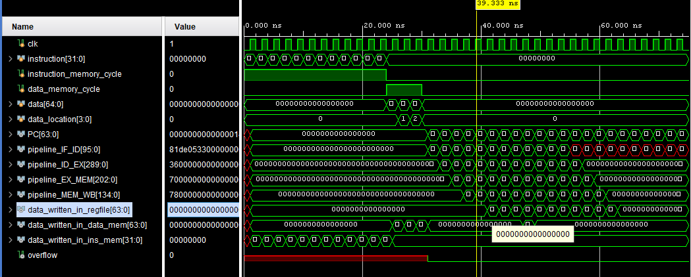
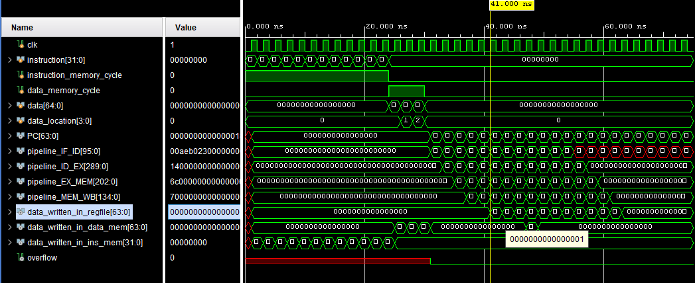
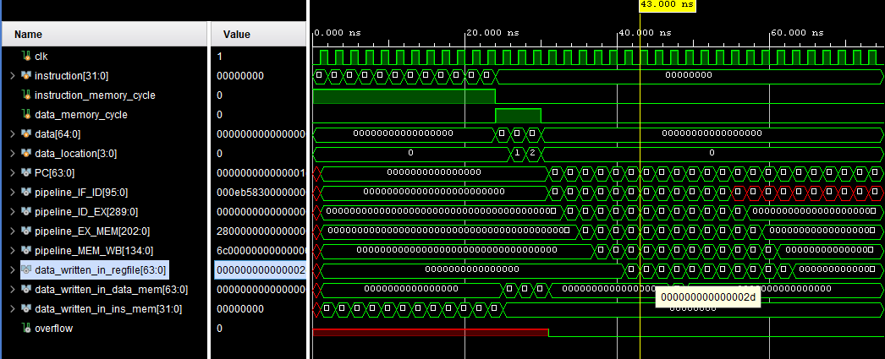
Page: 20
Instruction: addi x29, x29, 0. so data_written_in_regfile = 0 :
Instruction : addi x30, x30, 1. so data_written_in_regfile = 1.
Instruction : ld x28, 0(x29). so data_written_in_regfile = MEM[0] = 45 (2d in hexadecimal)

Slide 12
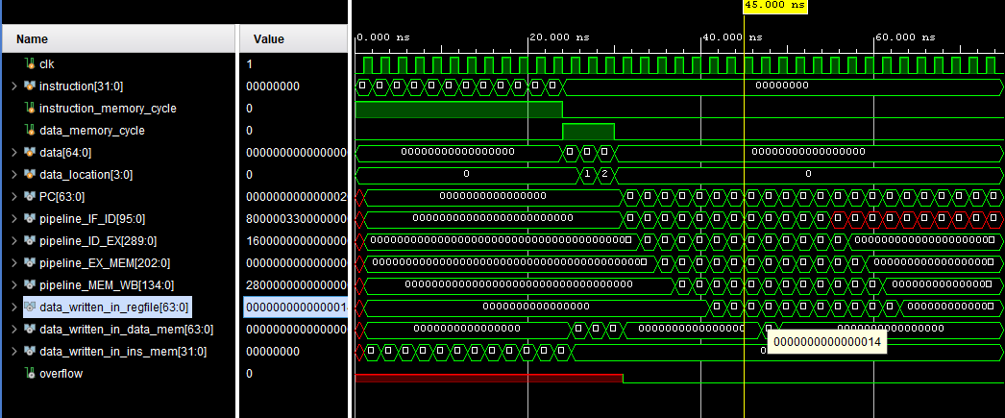
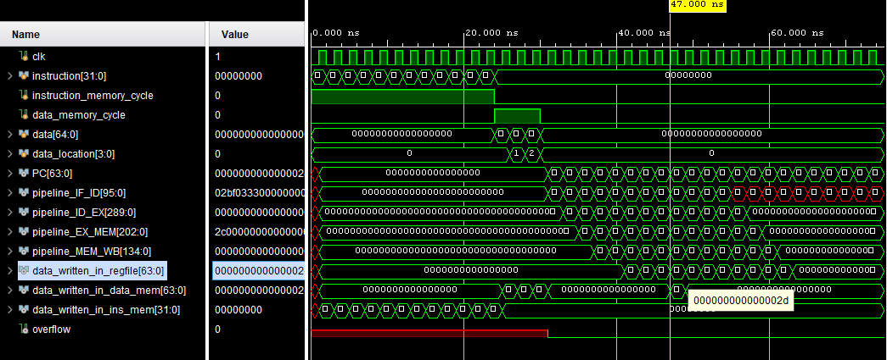
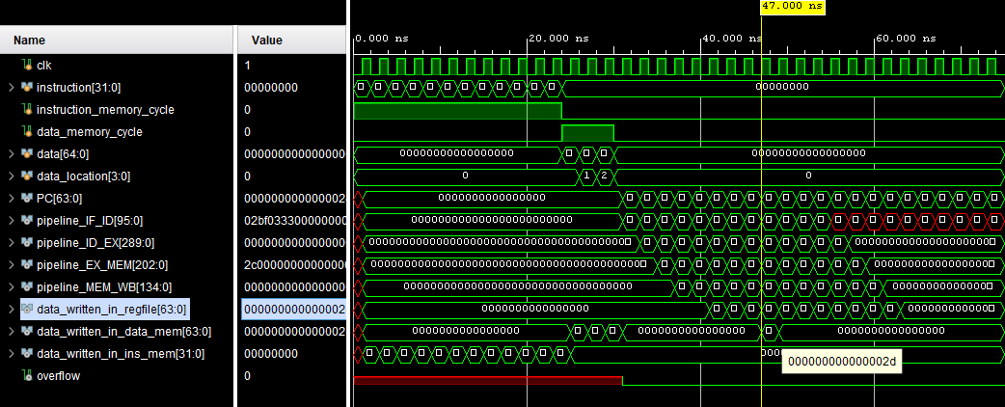
Page: 21
Instruction: ld x27, 0(x30). so data_written_in_regfile = MEM[1] = 20 (14 in dexadecimal) :
Instruction : add x10, x28, x29. so data_written_in_regfile = 45 + 0 = 45 . (2d in hexadecimal)
Instruction : sd x10, 0(x29). so data_written_in_datamem = 45(2d in hexadecimal):

Slide 13
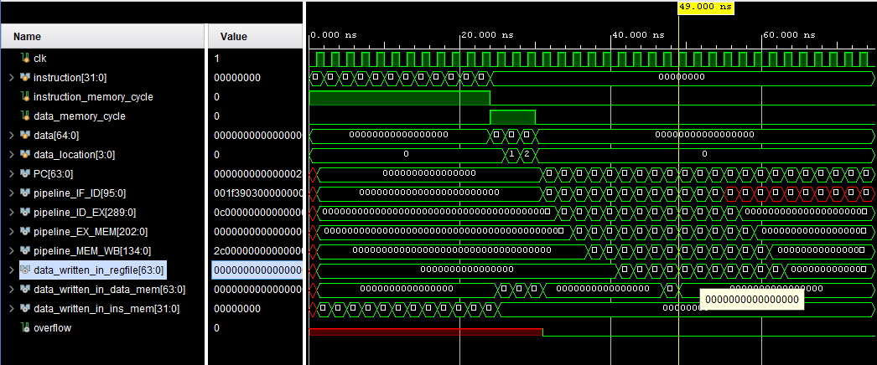
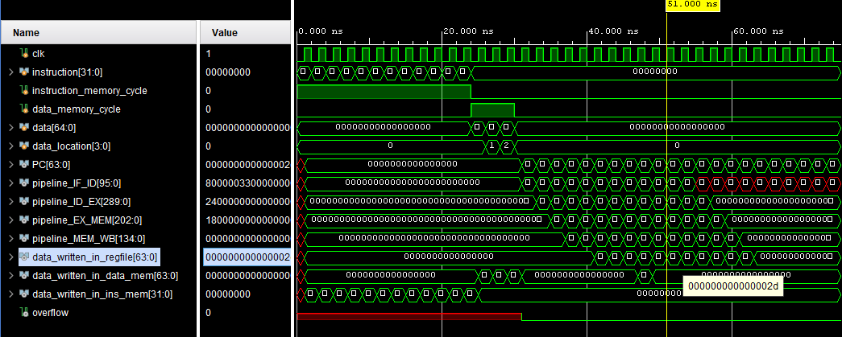
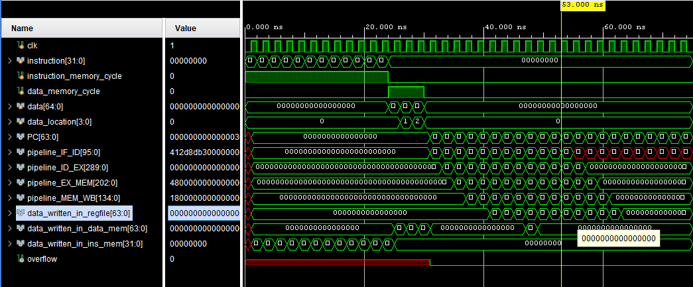
Page: 22
Instruction : sd x10, 0(x29). so nothing is written in register file.(so we got zero here )
Instruction : ld x11 0(x29). so data_written_in_regfile = MEM[0] = 45 . (2d in hexadecimal)
Instruction : add x0, x0, x0. stall so data_written_in_regfile = 0:

Slide 14
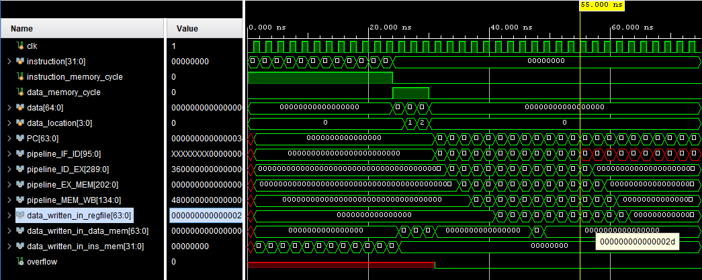
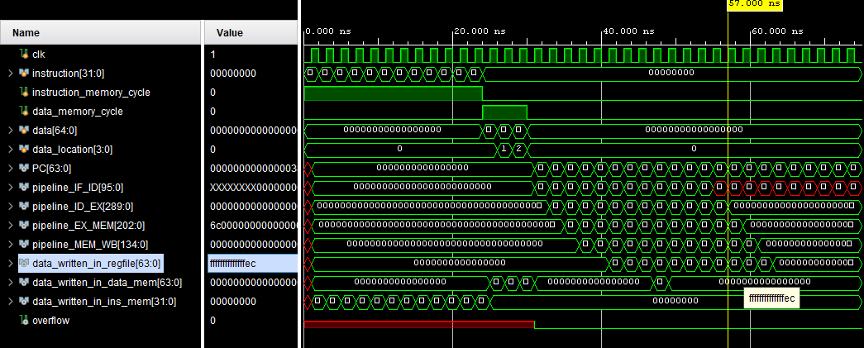
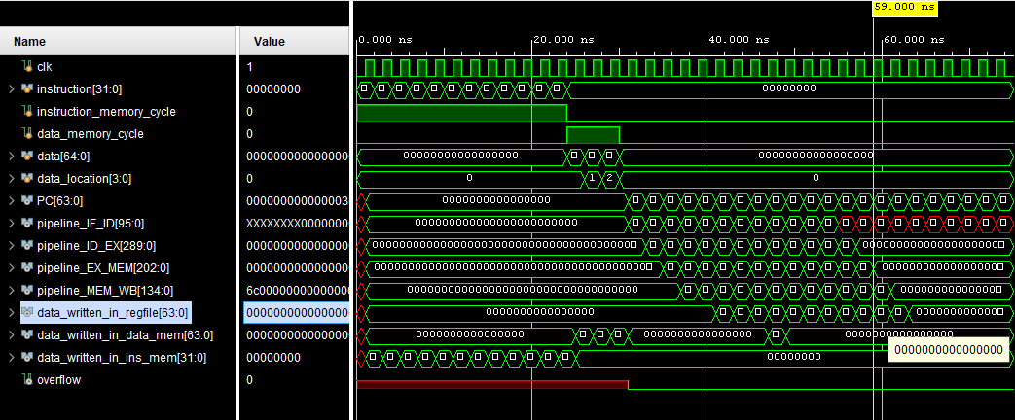
Page: 23
Instruction : mul x6, x11, x31. Data written in reg file = 45 * 1 = 45 [2d in hexadecimal]
Instruction : ld x18, 1(x30). so data_written_in_regfile = MEM[2] = -20:
Instruction : add x0, x0, x0. stall so data_written_in_regfile = 0:

Slide 15
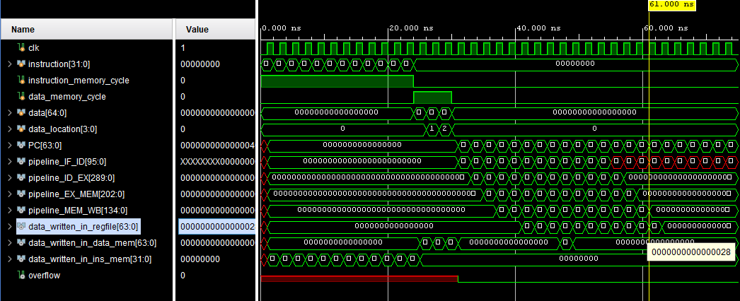
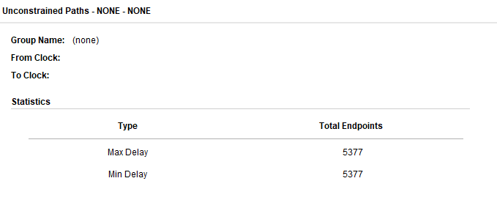
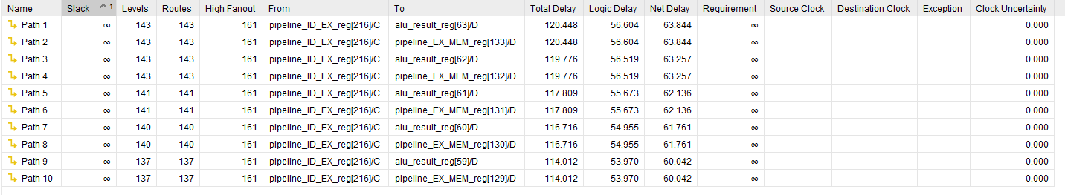
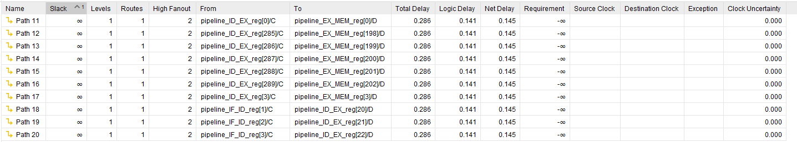
Page: 24
Instruction : sub x19, x27, x18. Data written in reg file = 20 – (-20) = 40 [28 in hexadecimal]
All the test cases are so far are passed successfully. If any further modifications are required it can be done by minor changes in Verilog code.
Time delays of written Verilog code:
Total critical path delay: 120.448 units.

Slide 16
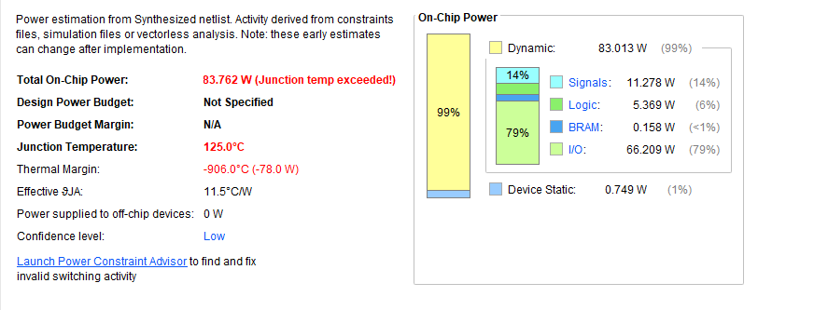
Page: 25
Power consumption of written Verilog code:
Maximum Power Consumption is 83.762W.

